Slide 1
CSE 332 Data Abstractions: Algorithmic, Asymptotic, and Amortized Analysis
Kate Deibel
Summer 2012

Slide 2
Announcements
Project 1 posted
Homework 0 posted
Homework 1 posted this afternoon
Feedback on typos is welcome
New Section Location: CSE 203
Comfy chairs! :O
White board walls! :o
Reboot coffee 100 yards away :)
Kate's office is even closer :/

Slide 3
Today
Briefly review math essential to algorithm analysis
Proof by induction
Powers of 2
Exponents and logarithms
Begin analyzing algorithms
Big-O, Big-Ω, and Big-Θ notations
Using asymptotic analysis
Best-case, worst-case, average case analysis
Using amortized analysis

Slide 4
Math Review
If you understand the first n slides, you will understand the n+1 slide

Slide 5
Recurrence Relations
Functions that are defined using themselves (think recursion but mathematically):
F(n) = n ∙ F(n-1), F(0) = 1
G(n) = G(n-1) + G(n-2), G(1)=G(2) = 1
H(n) = 1 + H( ⌊ n/2 ⌋ ), H(1)=1
Some recurrence relations can be written more simply in closed form (non-recursive)
⌊ x ⌋ is the floor function (first integer ≤x)
⌈ x ⌉ is the ceiling function (first integer ≥x)

Slide 6
Example Closed Form
H(n) = 1 + H( ⌊ n/2 ⌋ ), H(1)=1
H(1) = 1
H(2) = 1 + H(⌊ 2/2 ⌋ ) = 1 + H(1) = 2
H(3) = 1 + H(⌊ 3/2 ⌋ ) = 1 + H(1) = 2
H(4) = 1 + H(⌊ 4/2 ⌋ ) = 1 + H(2) = 3
...
H(8) = 1 + H(⌊ 8/2 ⌋ ) = 1 + H(4) = 4
…
H(n) = 1 + ⌊ log₂ n ⌋

Slide 7
Mathematical Induction
Suppose P(n) is some predicate (with integer n)
Example: n ≥ n/2 + 1
To prove P(n) for all n ≥ c, it suffices to prove
P(c) – called the “basis” or “base case”
If P(k) then P(k+1) – called the “induction step” or “inductive case”
When we will use induction:
To show an algorithm is correct or has a certain running time no matter how big a data structure or input value is
Our “n” will be the data structure or input size.

Slide 8
Induction Example
The sum of the first n powers of 2 (starting with zero) is given the by formula:
P(n) = 2^{n}-1
Theorem: P(n) holds for all n ≥ 1
Proof: By induction on n
Base case: n=1.
Sum of first power of 2 is 2⁰ , which equals 1.
And for n=1,
2^{n}-1 = 2¹-1 = 2-1 = 1

Slide 9
Induction Example
The sum of the first n powers of 2 (starting with zero) is given the by formula:
P(n) = 2^{n}-1
Inductive case:
Assume: sum of the first k powers of 2 is 2^{k}-1
Show: sum of the first (k+1) powers is 2^{k+1}-1
P(k+1) = 2⁰+2¹+…+2^{k+1-2}+2^{k+1-1} = (2⁰+2¹+…+2^{k-1})+2^{k} = (2^{k}-1)+2^{k} since P(k)=2⁰+2¹+…+2^{k-1}= 2^{k}-1 = 2∙2^{k}-1 = 2^{k+1}-1

Slide 10
Powers of 2
A bit is 0 or 1
n bits can represent 2^{n} distinct things
For example, the numbers 0 through 2^{n}-1
Rules of Thumb:
2¹⁰ is 1024 / “about a thousand”, kilo in CSE speak
2²⁰ is “about a million”, mega in CSE speak
2³⁰ is “about a billion”, giga in CSE speak
In Java:
int is 32 bits and signed, so “max int” is 2³¹ - 1 which is about 2 billion
long is 64 bits and signed, so “max long” is 2⁶³ - 1

Slide 11
Therefore…
One can give a unique id to:
Every person in the U.S. with 29 bits
Every person in the world with 33 bits
Every person to have ever lived with ≈38 bits
Every atom in the universe with 250-300 bits
So if a password is 128 bits long and randomly generated, do you think you could guess it?

Slide 12
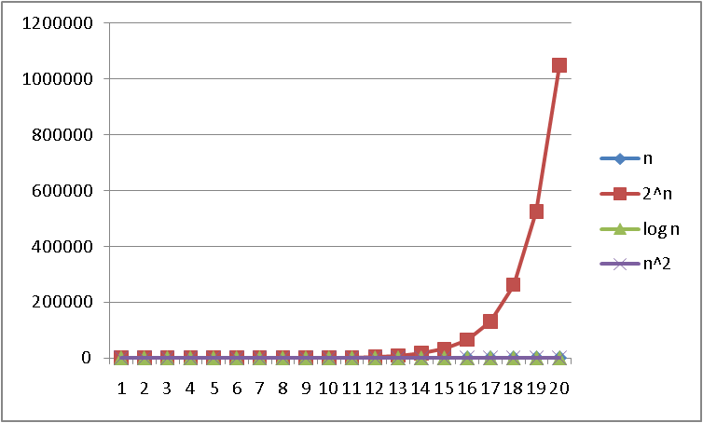
Logarithms and Exponents
Since so much in CS is in binary, log almost always means log₂
Definition: log₂ x = y if x = 2^{y}
So, log₂ 1,000,000 = “a little under 20”
Just as exponents grow very quickly, logarithms grow very slowly
See Excel file on course page to play with plot data!

Slide 13
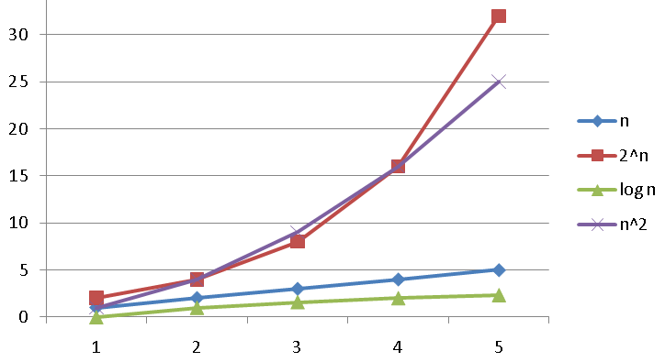
Logarithms and Exponents
Since so much in CS is in binary, log almost always means log₂
Definition: log₂ x = y if x = 2^{y}
So, log₂ 1,000,000 = “a little under 20”
Just as exponents grow very quickly, logarithms grow very slowly
See Excel file on course page to play with plot data!

Slide 14
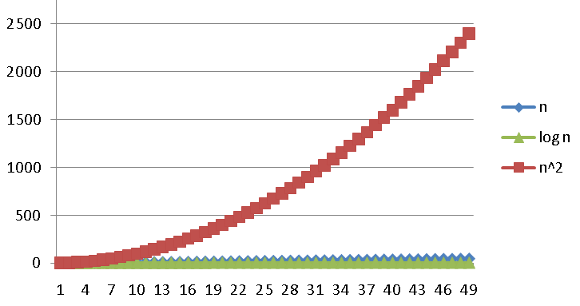
Logarithms and Exponents
Since so much in CS is in binary, log almost always means log₂
Definition: log₂ x = y if x = 2^{y}
So, log₂ 1,000,000 = “a little under 20”
Just as exponents grow very quickly, logarithms grow very slowly
See Excel file on course page to play with plot data!

Slide 15
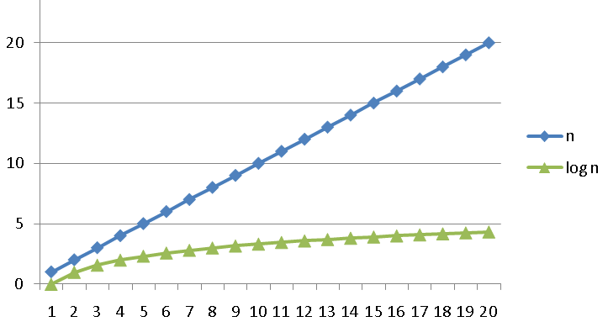
Logarithms and Exponents
Since so much in CS is in binary, log almost always means log₂
Definition: log₂ x = y if x = 2^{y}
So, log₂ 1,000,000 = “a little under 20”
Just as exponents grow very quickly, logarithms grow very slowly
See Excel file on course page to play with plot data!

Slide 16
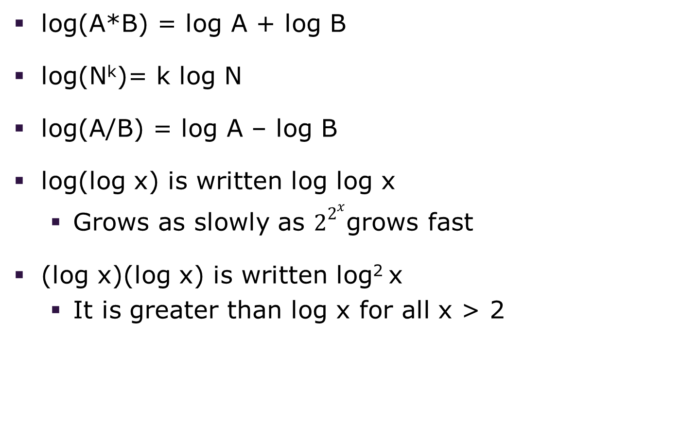
Logarithms and Exponents
log(A*B) = log A + log B
log(N^{k})= k log N
log(A/B) = log A – log B
log(log x) is written log log x
Grows as slowly as $2^{2^{x}}$grows fast
(log x)(log x) is written log² x
It is greater than log x for all x > 2

Slide 17
Logarithms and Exponents
Any base B log is equivalent to base 2 log within a constant factor
In particular,
log₂ x = 3.22 log₁₀ x
In general,
log_{B} x = (log_{A} x) / (log_{A} B)
This matters in doing math but not CS!
In algorithm analysis, we tend to not care much about constant factors

Slide 18
Algorithm Analysis
Get out your stopwatches… or not

Slide 19
Algorithm Analysis
As the “size” of an algorithm’s input grows (array length, size of queue, etc.):
Time: How much longer does it run?
Space: How much memory does it use?
How do we answer these questions?
For now, we will focus on time only.

Slide 20
One Approach to Algorithm Analysis
Why not just code the algorithm and time it?
Hardware: processor(s), memory, etc.
OS, version of Java, libraries, drivers
Programs running in the background
Implementation dependent
Choice of input
Number of inputs to test

Slide 21
The Problem with Timing
Timing doesn’t really evaluate the algorithm but merely evaluates a specific implementation
At the core of CS is a backbone of theory & mathematics
Examine the algorithm itself, not the implementation
Reason about performance as a function of n
Mathematically prove things about performance
Yet, timing has its place
In the real world, we do want to know whether implementation A runs faster than implementation B on data set C
Ex: Benchmarking graphics cards

Slide 22
Basic Lesson
Evaluating an algorithm?
Use asymptotic analysis
Evaluating an implementation?
Use timing

Slide 23
Goals of Comparing Algorithms
Many measures for comparing algorithms
Security
Clarity/ Obfuscation
Performance
When comparing performance
Use large inputs because probably any algorithm is “plenty good” for small inputs (n < 10 always fast)
Answer should be independent of CPU speed, programming language, coding tricks, etc.
Answer is general and rigorous, complementary to “coding it up and timing it on some test cases”

Slide 24
Assumptions in Analyzing Code
Basic operations take constant time
Arithmetic (fixed-width)
Assignment
Access one Java field or array index
Comparing two simple values (is x < 3)
Other operations are summations or products
Consecutive statements are summed
Loops are (cost of loop body) ╳ (number of loops)
What about conditionals?

Slide 25
Worst-Case Analysis
In general, we are interested in three types of performance
Best-case / Fastest
Average-case
Worst-case / Slowest
When determining worst-case, we tend to be pessimistic
If there is a conditional, count the branch that will run the slowest
This will give a loose bound on how slow the algorithm may run

Slide 26
Analyzing Code
What are the run-times for the following code?
for(int i=0;i<n;i++) x = x+1;
for(int i=0;i<n;i++) for(int j=0;j<n;j++) x = x + 1
for(int i=0;i<n;i++) for(int j=0; j <= i); j++) x = x + 1
Answers are
≈1+4n
≈4n²
≈ 4(1+2+…+n)
≈ 4n(n+1)/2
≈ 2n²+2n+2

Slide 27
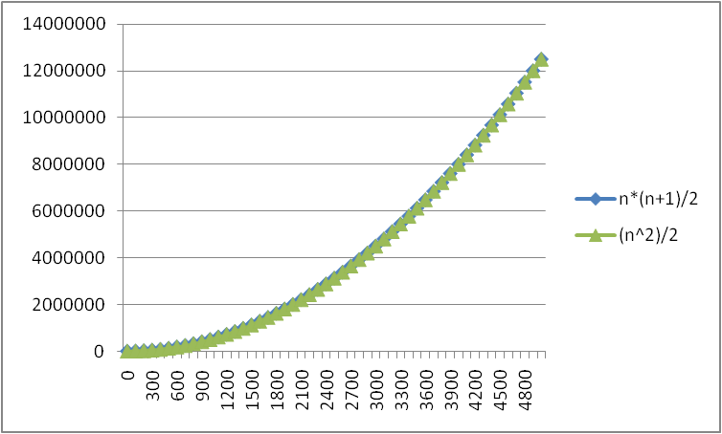
No Need To Be So Exact
Constants do not matter
Consider 6N² and 20N²
When N >> 20, the N² is what is driving the function's increase
Lower-order terms are also less important
N*(N+1)/2 vs. just N²/2
The linear term is inconsequential
We need a better notation for performance that focuses on the dominant terms only

Slide 28
Big-Oh Notation
Given two functions f(n) & g(n) for input n, we say f(n) is in O(g(n) ) iff there exist positive constants c and n₀ such that f(n) ≤ c g(n) for all n ≥ n₀
Basically, we want to find a function g(n) that is eventually always bigger than f(n)
g
f
n₀
n

Slide 29
The Gist of Big-Oh
Take functions f(n) & g(n), consider only the most significant term and remove constant multipliers:
5n+3 → n
7n+.5n²+2000 → n²
300n+12+nlogn → n log n
–n → ??? A negative run-time?
Then compare the functions; if f(n) ≤ g(n), then f(n) is in O(g(n))

Slide 30
A Big Warning
Do NOT ignore constants that are not multipliers:
n³ is O(n²) is FALSE
3^{n} is O(2^{n}) is FALSE
When in doubt, refer to the rigorous definition of Big-Oh

Slide 31
Examples
True
False
False
True
True or false?
4+3n is O(n)
n+2 logn is O(log n)
logn+2 is O(1)
n⁵⁰ is O(1.1^{n})

Slide 32
Examples (cont.)
For f(n)=4n & g(n)=n², prove f(n) is in O(g(n))
A valid proof is to find valid c and n₀
When n=4, f=16 and g=16, so this is the crossing over point
We can then chose n₀ = 4, and c=1
We also have infinitely many others choices for c and n₀, such as n₀ = 78, and c=42

Slide 33
Big Oh: Common Categories
From fastest to slowest
O(1) constant (or O(k) for constant k)
O(log n) logarithmic
O(n) linear
O(n log n) "n log n”
O(n²) quadratic
O(n³) cubic
O(n^{k}) polynomial (where is k is constant)
O(k^{n}) exponential (where constant k > 1)

Slide 34
Caveats
Asymptotic complexity focuses on behavior for large n and is independent of any computer/coding trick, but results can be misleading
Example: n^{1/10} vs. log n
Asymptotically n^{1/10} grows more quickly
But the “cross-over” point is around 5 * 10¹⁷
So if you have input size less than 2⁵⁸, prefer n^{1/10}
Similarly, an O(2^{n}) algorithm may be more practical than an O(n⁷) algorithm

Slide 35
Caveats
Even for more common functions, comparing O() for small n values can be misleading
Quicksort: O(n log n) (expected)
Insertion Sort: O(n²)(expected)
In reality Insertion Sort is faster for small n’s so much so that good QuickSort implementations switch to Insertion Sort when n<20

Slide 36
Comment on Notation
We say (3n²+17) is in O(n²)
We may also say/write is as
(3n²+17) is O(n²)
(3n²+17) = O(n²)
(3n²+17) ∈ O(n²)
But it’s not ‘=‘ as in ‘equality’:
We would never say O(n²) = (3n²+17)

Slide 37
Big Oh’s Family
Big Oh: Upper bound: O( f(n) ) is the set of all functions asymptotically less than or equal to f(n)
g(n) is in O( f(n) ) if there exist constants c and n₀ such that
g(n) ≤ c f(n) for all n ≥ n₀
Big Omega: Lower bound: Ω( f(n) ) is the set of all functions asymptotically greater than or equal to f(n)
g(n) is in Ω( f(n) ) if there exist constants c and n₀ such that
g(n) ≥ c f(n) for all n ≥ n₀
Big Theta: Tight bound: Θ( f(n) ) is the set of all functions asymptotically equal to f(n)
Intersection of O( f(n) ) and Ω( f(n) )

Slide 38
Regarding use of terms
Common error is to say O(f(n)) when you mean Θ(f(n))
People often say O() to mean a tight bound
Say we have f(n)=n; we could say f(n) is in O(n), which is true, but only conveys the upper-bound
Somewhat incomplete; instead say it is Θ(n)
That means that it is not, for example O(log n)
Less common notation:
“little-oh”: like “big-Oh” but strictly less than
Example: sum is o(n²) but not o(n)
“little-omega”: like “big-Omega” but strictly greater than
Example: sum is ω(log n) but not ω(n)

Slide 39
Putting them in order
ω(…) < Ω(…) ≤ f(n) ≤ O(…) < o(...)

Slide 40
Do Not Be Confused
Best-Case does not imply Ω(f(n))
Average-Case does not imply Θ(f(n))
Worst-Case does not imply O(f(n))
Best-, Average-, and Worst- are specific to the algorithm
Ω(f(n)), Θ(f(n)), O(f(n)) describe functions
One can have an Ω(f(n)) bound of the worst-case performance (worst is at least f(n))
Once can have a Θ(f(n)) of best-case (best is exactly f(n))

Slide 41
Now to the Board
What happens when we have a costly operation that only occurs some of the time?
Example:
My array is too small. Let's enlarge it.
Option 1: Increase array size by 10
Copy old array into new one
Option 2: Double the array size
Copy old array into new one
We will now explore amortized analysis!

Slide 42
Stretchy Array (version 1)
StretchyArray:
maxSize: positive integer (starts at 1)
array: an array of size maxSize
count: number of elements in array
put(x): add x to the end of the array
if maxSize == count
make new array of size (maxSize + 5)
copy old array contents to new array
maxSize = maxSize + 5
array[count] = x
count = count + 1

Slide 43
Stretchy Array (version 2)
StretchyArray:
maxSize: positive integer (starts at 0)
array: an array of size maxSize
count: number of elements in array
put(x): add x to the end of the array
if maxSize == count
make new array of size (maxSize * 2)
copy old array contents to new array
maxSize = maxSize * 2
array[count] = x
count = count + 1

Slide 44
Performance Cost of put(x)
In both stretchy array implementations, put(x)is defined as essentially: if maxSize == count
make new array of bigger size
copy old array contents to new array
update maxSize
array[count] = x
count = count + 1
What f(n) is put(x) in O( f(n) )?

Slide 45
Performance Cost of put(x)
In both stretchy array implementations, put(x)is defined as essentially: if maxSize == count O(1)
make new array of bigger size O(1)
copy old array contents to new array O(n)
update maxSize O(1)
array[count] = x O(1)
count = count + 1 O(1)
In the worst-case, put(x) is O(n) where n is the current size of the array!!

Slide 46
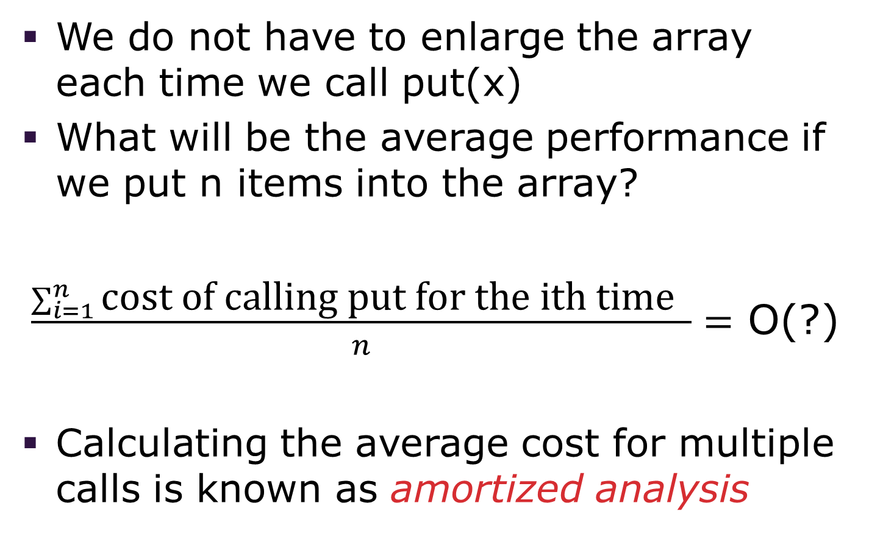
But…
We do not have to enlarge the array each time we call put(x)
What will be the average performance if we put n items into the array?
$\frac{\sum_{i=1}^{n}{\text{cost} \text{of} \text{calling} \text{put} \text{for} \text{the} \text{ith} \text{time} }}{n}=$ O(?)
Calculating the average cost for multiple calls is known as amortized analysis

Slide 47
Amortized Analysis of StretchyArray Version 1
i | maxSize | count | cost | comments
 | 0 | 0 |  | Initial state
1 | 5 | 1 | 0 + 1 | Copy array of size 0
2 | 5 | 2 | 1
3 | 5 | 3 | 1
4 | 5 | 4 | 1
5 | 5 | 5 | 1
6 | 10 | 6 | 5 + 1 | Copy array of size 5
7 | 10 | 7 | 1
8 | 10 | 8 | 1
9 | 10 | 9 | 1
10 | 10 | 10 | 1
11 | 15 | 11 | 10 + 1 | Copy array of size 10
⁞ | ⁞ | ⁞ | ⁞ | ⁞

Slide 48
Amortized Analysis of StretchyArray Version 1
i | maxSize | count | cost | comments
 | 0 | 0 |  | Initial state
1 | 5 | 1 | 0 + 1 | Copy array of size 0
2 | 5 | 2 | 1
3 | 5 | 3 | 1
4 | 5 | 4 | 1
5 | 5 | 5 | 1
6 | 10 | 6 | 5 + 1 | Copy array of size 5
7 | 10 | 7 | 1
8 | 10 | 8 | 1
9 | 10 | 9 | 1
10 | 10 | 10 | 1
11 | 15 | 11 | 10 + 1 | Copy array of size 10
⁞ | ⁞ | ⁞ | ⁞ | ⁞
Every five steps, we have to do a multiple of five more work

Slide 49
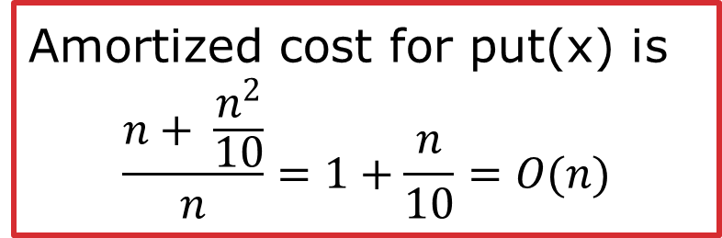
Amortized Analysis of StretchyArray Version 1
Assume the number of puts is n=5k
We will make n calls to array[count]=x
We will stretch the array k times and will cost:
0 + 5 + 10 + … + 5(k-1)
Total cost is then:
n + (0 + 5 + 10 + … + 5(k-1))
= n + 5(1 + 2 + … +(k-1))
= n + 5(k-1)(k-1+1)/2
= n + 5k(k-1)/2
≈ n + n²/10
Amortized cost for put(x) is $$\frac{n+ \frac{n^{2}}{10}}{n}=1+\frac{n}{10}=O(n)$$

Slide 50
Amortized Analysis of StretchyArray Version 2
i | maxSize | count | cost | comments
 | 1 | 0 |  | Initial state
1 | 1 | 1 | 1
2 | 2 | 2 | 1 + 1 | Copy array of size 1
3 | 4 | 3 | 2 + 1 | Copy array of size 2
4 | 4 | 4 | 1
5 | 8 | 5 | 4 + 1 | Copy array of size 4
6 | 8 | 6 | 1
7 | 8 | 7 | 1
8 | 8 | 8 | 1
9 | 16 | 9 | 8 + 1 | Copy array of size 8
10 | 16 | 10 | 1
11 | 16 | 11 | 1
⁞ | ⁞ | ⁞ | ⁞ | ⁞

Slide 51
Amortized Analysis of StretchyArray Version 2
i | maxSize | count | cost | comments
 | 1 | 0 |  | Initial state
1 | 1 | 1 | 1
2 | 2 | 2 | 1 + 1 | Copy array of size 1
3 | 4 | 3 | 2 + 1 | Copy array of size 2
4 | 4 | 4 | 1
5 | 8 | 5 | 4 + 1 | Copy array of size 4
6 | 8 | 6 | 1
7 | 8 | 7 | 1
8 | 8 | 8 | 1
9 | 16 | 9 | 8 + 1 | Copy array of size 8
10 | 16 | 10 | 1
11 | 16 | 11 | 1
⁞ | ⁞ | ⁞ | ⁞ | ⁞
Enlarge steps happen basically when i is a power of 2

Slide 52
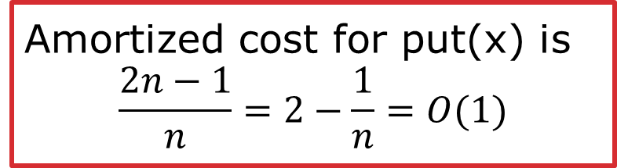
Amortized Analysis of StretchyArray Version 2
Assume the number of puts is n=2^{k}
We will make n calls to array[count]=x
We will stretch the array k times and will cost:
≈1 + 2 + 4 + … + 2^{k-1}
Total cost is then:
≈ n + (1 + 2 + 4 + … + 2^{k-1})
≈ n + 2^{k} – 1
≈ 2n - 1
Amortized cost for put(x) is $$\frac{2n−1}{n}=2−\frac{1}{n}=O(1)$$

Slide 53
The Lesson
With amortized analysis, we know that over the long run (on average):
If we stretch an array by a constant amount, each put(x) call is O(n) time
If we double the size of the array each time, each put(x) call is O(1) time

